Slide 1
Clinical and Workflow Optimisation Services for BD Kiestra™
Accelerate your microbiology laboratory automation transformation
© 2022 BD. BD, the BD Logo and Kiestra are trademarks of Becton, Dickinson and Company.

Slide 2
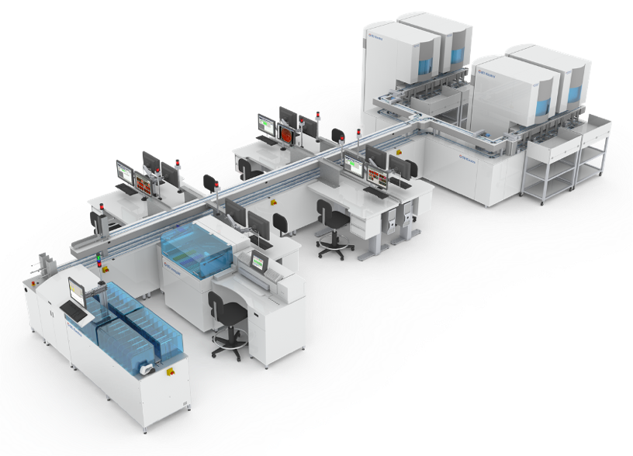
Clinical and Workflow Optimisation Services for BD KiestraTM A range of services that will help you achieve your key performance goals
Shrinking lab budgets and requirement to optimise labour spending
Consolidation and volume growth with limited resources (equipment, people, space)
Improvements to productivity and efficiency
Deliver accurate results faster (reduced TAT) without compromising quality
Many labs are looking to overcome these challenges with automation
Microbiology labs are facing many challenges today^{1,2}
© 2022 BD. BD, the BD Logo and Kiestra are trademarks of Becton, Dickinson and Company.

Slide 3
Implementation of automation requires transformation
“…simply automating the conventional process...misses the efficiency gains that partial and total automation can provide.”
R.B. Thomson Jr, E. McElvania, Total Laboratory Automation. What Is Gained, What Is Lost, and Who Can Afford It?, Clin Lab Med (2019), 371-389. DOI:https://doi.org/10.1016/j.cll.2019.05.002
© 2022 BD. BD, the BD Logo and Kiestra are trademarks of Becton, Dickinson and Company.

Slide 4
Maximising the value of automation
Achieving enhanced goals
Current configuration
Current equip
Current process
New equipment
New equip
Current process
Minor improvement
New process and equipment
New equip
New process
Larger improvement
Our solution
Maximise the value of your investment through combining new technology and enhancing processes
© 2022 BD. BD, the BD Logo and Kiestra are trademarks of Becton, Dickinson and Company.
Notes:
How to achieve optimization of automation
How to achieve maximum value from automation

Slide 5
Understanding the optimised lab equation
Automation
Workflow
People
Optimised lab
Successful application of the optimised lab equation requires time, knowledge and experience.
© 2022 BD. BD, the BD Logo and Kiestra are trademarks of Becton, Dickinson and Company.

Slide 6
Clinical and Workflow Optimisation Services for BD KiestraTM Comprehensive professional services designed to streamline implementation of automation, optimise workflow and support continuous improvement
Maximise the financial benefit from the investment in automation³
Advance laboratory outcomes by designing processes with less waste and rework³
Enhance laboratory operations by increasing efficiency and streamlining workflow⁴
Implement a culture of continuous process improvement for sustained success
© 2022 BD. BD, the BD Logo and Kiestra are trademarks of Becton, Dickinson and Company.

Slide 7
Clinical and Workflow Optimisation Services for BD KiestraTM Gain confidence throughout your automation transformation with hands-on support from a BD expert
BD workflow consultants
Benefits to you
Experts in Lean methodology
Confidence to embark on your laboratory transformation with a trusted partner providing the knowledge, experience and resources to help you succeed
Hands-on experience optimising BD solutions
Real-world clinical laboratory experience
Multi-lingual team who speaks your language
© 2022 BD. BD, the BD Logo and Kiestra are trademarks of Becton, Dickinson and Company.
Notes:
The BD workflow consulting team has combined decades of education and expertise in Lean methodologies in laboratory and other business settings.
We have unique, real-world clinical laboratory experience from both hospital laboratory and reference laboratory settings.
Our global reach means we bring best practice workflows from around the world right into your lab.

Slide 8
Clinical and Workflow Optimisation Services for BD KiestraTM Lean principles can improve processes by increasing value through decreasing waste
WASTE
BD’s workflow optimisation services are rooted in Lean principles which aim to identify and remove waste from work processes, so that your teams can focus on more valuable tasks.
Non-value added work
Defects
Excess inventory
Un-optimised labour
Overproduction
VALUE
Productivity
Efficiency
Workforce satisfaction
Cost containment
Return on investment
© 2022 BD. BD, the BD Logo and Kiestra are trademarks of Becton, Dickinson and Company.

Slide 9
Clinical and Workflow Optimisation Services for BD KiestraTM Leverage BD best practice tools and training to build your transformation toolkit
Our tools
Our
training
Your comprehensive toolkit for success
Lean process mapping
Value stream mapping
Robust simulation tools
Lean
education
Lab layout tools
Visual daily management
Hands-on
coaching
Our goal is not only to help you achieve your initiatives, but to educate, equip and empower you to make and sustain improvements.
© 2022 BD. BD, the BD Logo and Kiestra are trademarks of Becton, Dickinson and Company.
Notes:
Our best practice methodology is based on years of experience and has proven effective with laboratories of all sizes with many unique challenges.
We know each laboratory is different, so we spend the time to understand your operations by taking a deep dive into the workflow on each shift and in each area of work. We study your processes, your schedules and your data, reviewing with you along the way. We get to know you like we are part of your team. This attention to detail means our recommendations are actionable and relevant to your needs.
We use powerful tools to reveal inefficiencies, identify value, simulate future workflows and predict operational impact and to visualize changes to your laboratory layout. We offer support in deploying Lean training to your teams and implementing Visual Daily Management principles in your lab.
Our goal is not only to help you achieve your initiatives, but to educate and empower you to make and sustain the improvements. We accomplish this through various avenues including on-site and off-site coaching, instructor-led classroom training and continuously sharing our knowledge throughout the project.

Slide 10
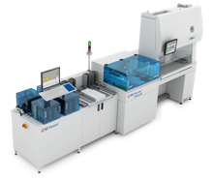
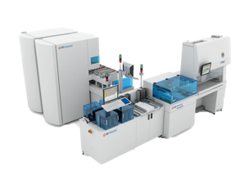
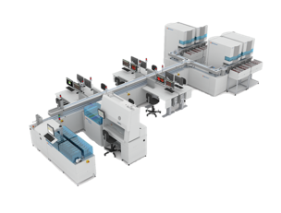
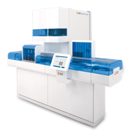
Clinical and Workflow Optimisation Services for BD KiestraTM Services that build upon and enhance your automation investment
Workflow Services
Premium*
Premium service for a lean culture conversion
3
Enhanced
Enhanced service for workflow change acceleration
2
Value
Essential
Essential service for automation readiness
1
Automation
*not available in 2022
© 2022 BD. BD, the BD Logo and Kiestra are trademarks of Becton, Dickinson and Company.
Notes:
How to include other disciplines here ? ID/AST, etc.

Slide 11
Clinical and Workflow Optimisation Services for BD KiestraTM Three programs available to meet the needs of your facility
Enhanced
Essential
Premium*
Standard
Standard
Advance your laboratory by learning how to improve key metrics and performance indicators using Lean principles and tools. Empower your team to embrace a continuous improvement culture.
Standard
Improve your laboratory through designing, planning and implementing a customised automation solution to solve basic laboratory challenges.
Expand Lean competencies and adoption across your organisational structure to encourage development of a Lean management operation.
Contents of the Essential and Enhanced services, plus:
Customised lean training for a Leadership audience
Lean goal setting and strategy alignment workshop and tools
Lean inventory management training and process improvement event to set up Kanban
Routine coaching touchpoints for leadership and supply chain teams
Baseline performance report and identification of high-level opportunities for improvement
Custom visualisation of automation in your laboratory
Access to basic best practices for you to implement
Basic training on workflow related data analytics
Post-implementation assessment to occur within 6 months post go-live
Contents of the Essential service, plus:
Introductory Lean training and toolkit
Thorough current state assessment and gap analysis
Custom improvement recommendations and action plan driven by a BD expert
On-site expert led process improvement event
Visual Daily Management (VDM) training and tools
Quarterly Lean Process Health Chart(s)
Routine coaching by a Lean expert with laboratory experience
*not available in 2022
© 2022 BD. BD, the BD Logo and Kiestra are trademarks of Becton, Dickinson and Company.

Slide 12
Plebani M. Clinical laboratories: production industry or medical services? Clinical Chemistry and Laboratory Medicine (CCLM). 2015;53(7). doi:10.1515/cclm-2014-1007
Vandenberg O, Durand G, Hallin M, et al. Consolidation of Clinical Microbiology Laboratories and Introduction of Transformative Technologies. Clin Microbiol Reviews. 2020;33(2):e00057-19, /cmr/33/2/CMR.00057-19.atom. doi:10.1128/CMR.00057-19
Croxatto, Antony, Klaas Dijkstra, Guy Prod'hom, and Gilbert Greub. "Comparison of inoculation with the InoqulA and WASP automated systems with manual inoculation." Journal of clinical microbiology 53, no. 7 (2015): 2298-2307. DOI: https://doi.org/10.1128/JCM.03076-14
Yue, Pinli, Menglan Zhou, Lintao Zhang, Qiwen Yang, Hongmei Song, Zhipeng Xu, Ge Zhang, Xiuli Xie, and Yingchun Xu. "Clinical performance of BD Kiestra InoqulA automated system in a Chinese Tertiary Hospital." Infection and drug resistance 13 (2020): 941. doi: 10.2147/IDR.S245173
© 2022 BD. BD, the BD Logo and Kiestra are trademarks of Becton, Dickinson and Company.

